Slide 1
INTRODUCTION TO QUANTUM MECHANICS
OR
WHY CHEMISTRY IS DIFFICULT TO LEARN
Electrons (and photons) DO NOT behave
according to Newton’s Laws of Motion
But, Chemistry is all about electrons
Feynman, from Lectures on Physics III :
“Quantum Mechanics exactly describes the behavior electrons and light.”
“Electrons and light do not behave like anything we have ever seen.”
“There is one lucky break, however—electrons behave just like light”

Slide 2
chmy361 Lec46
Mon 2dec12
Understanding Quantum Mechanics?
Richard Feynman lecturing to a lay audience at Cornell, circa. 1965:
“There was a time when the newspapers said that only twelve men understood the theory of relativity.
I do not believe there ever was such a time...
After they read the paper, quite a lot of people understood the theory of relativity... On the other hand, I think it is safe to say that
no one “understands” quantum mechanics...
Do not keep saying to your self “But how can it be like that?”, because you will get “down the drain” into a blind alley from which nobody has yet escaped. NOBODY KNOWS HOW IT CAN BE LIKE THAT. “
--Richard P. Feynman
Chapter 6, The Character of Physical Law, 23rd Printing, 1998

Slide 3
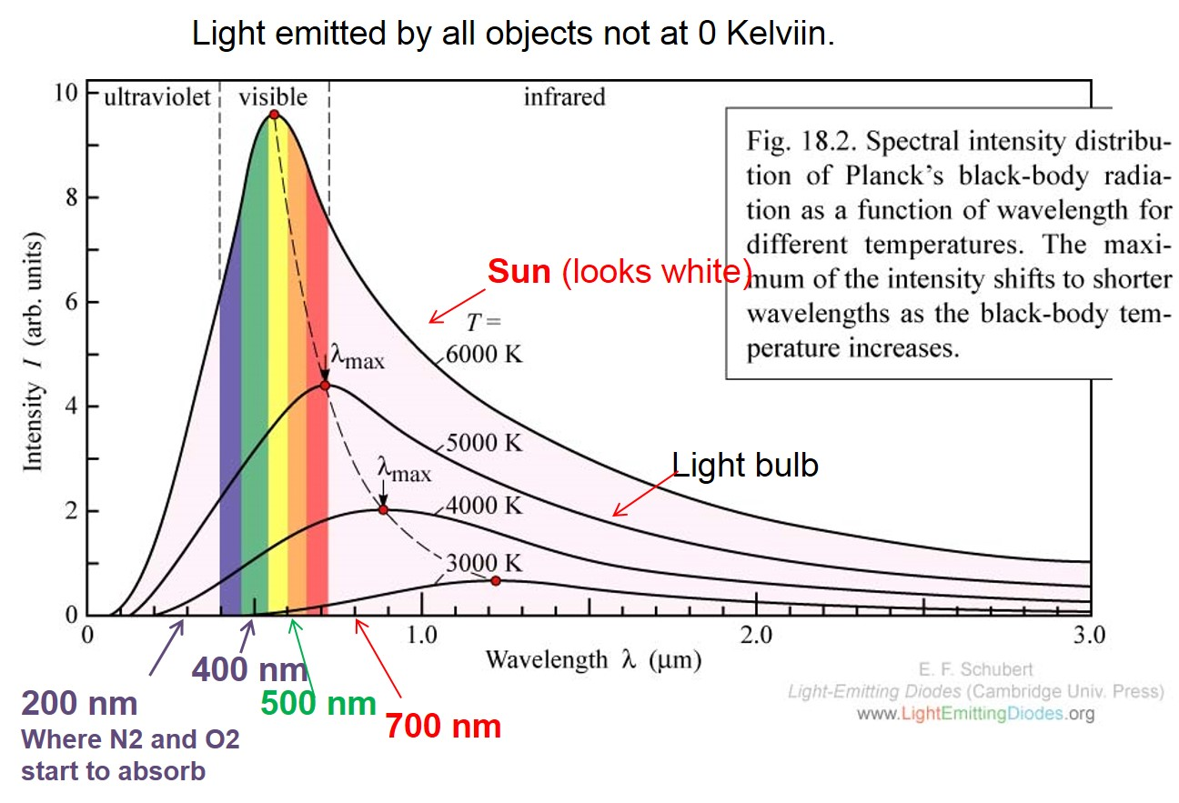
361 Lec 42
Mon, 16nov15
Around 1905, Max Planck was working hard on trying to understand this behavior.
Classical mechanics worked fine at the LONG wavelengths but NOT at short wavelengths.
Planck found that if energy of matter was quantized so that ΔE = hν = hc/λ
then classical mechanics predicted the curves perfectly!!!!
Planck varied h and found that 6.62 x 10⁻³⁴ gave a perfect match to experiment.
In other words, h is an experimentally derived constant.
No theory predicts h

Slide 4
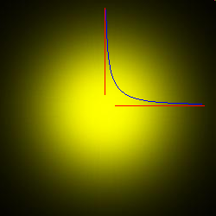
So was born the FIRST QUANTUM CONCEPT: Energy is quantized!
Classical thinking does not work for light. ΔE = hν
If the structure of the atom were known in 1905 this would have been
much more evident.
The mystery could be stated as a very striking problem obvious to chemists.
THE ELECTRON WILL NOT FALL TO THE NUCLEUS!!!
despite ENORMOUS Coulomb force.
The lowest energy
state (1s orbital) of the hydrogen
atom.
+ -
proton electron
Probability slice through the 1s orbital. The blue line is the square of the wavefunction (orbital).
Most probable point is AT NUCLEUS.
Most probable DISTANCE is AT Bohr radius

Slide 5
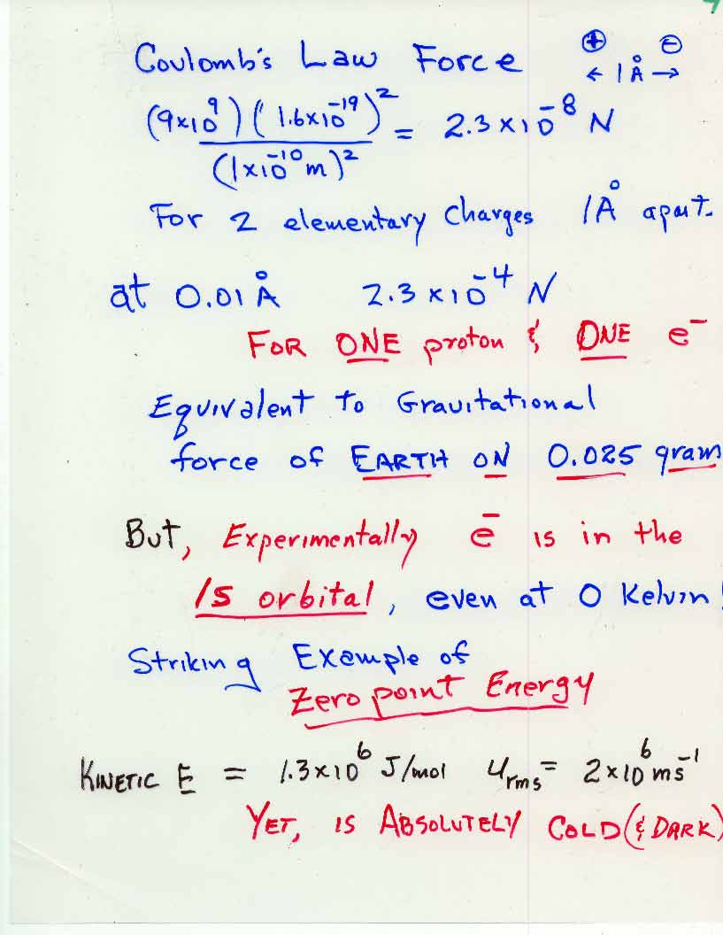

Slide 6
Quantum Behavior & Quantum Mechanics
Applies to EVERYTHING
But most evident for particles with mass equal or less than proton
Absolutely NECESSARY for electrons and light (photons),
which are neither particles or waves;
there is nothing like them in the macroscopic world !
Thus, Quantum Mechanics cannot be “understood” in the usual sense—not even
by the world’s greatest minds.
Quantum Mechanics was discovered—NOT derived
Newton’s Laws, however, CAN be derived from quantum mechanics
Quantum Mechanics has never failed to agree with experiment—yet.

Slide 7
Quantum Concepts
Who When What Equation
1. Planck 1905 Quantization of Energy ΔE = hν
2. Einstein 1905 Particle Nature of Light p = h/λ
3. DeBroglie ~1920 Wave Nature of Particles λ = h/p
4. Bohr ~1920 Quantization of L² = l(l+1) (h/2π)² ; Angular Momentum L_{z} = m (h/2π)
2L+1 m values from –L to +L
5. Heisenberg ~1925 Uncertainty Principle Δp_{x} Δx ≅ h
or: “why the electron does not
fall into the nucleus”
i.e., the concept of
ZERO POINT ENERGY

Slide 8
More on zero point energy and uncertainty principle
Zero point kinetic energy is ≅ h² /(m Δx²), where h = Planck’s constant, m = mass, and Δx is the length of the region to which the particle is confined. For example, as a nucleus pulls an electron close, the zero-point energy increases and the electron will not fall to the nucleus. (It is as if the small things like electrons "refuse" to be localized.)
Note: h² = J² s² = kg² m⁴s⁻⁴ s² , so h² /(m Δx²) = kg² m⁴s⁻² /(kgm²) = kg m²s⁻² = J
Heisenberg Uncertainty: Δx Δp ≅ h , i.e., product of uncertainty in x and uncertainty in momentum is about = h.
ΔH of chemical reactions is equal to the change in quantum zero point energy at 0 Kelvin, and is only slightly different at room temperature due to heat capacity differences.
The mysterious “DARK ENERGY” that is apparently causing the acceleration of expansion of the Universe is most discussed as quantum zero point energy (of gravity, for which there is no quantum theory yet.)

Slide 9
THEN CAME THE Schrödinger Equation (1926)
which says all of the above
This equation was DISCOVERED, not derived
Schrodinger did not know what to make of Ψ when he published
his equation. Everyone knew it was important because
the equation gave all the correct energies for the “well behaved”
solutions.
Also was immediately shown that Newton’s Laws could be
derived from the Schrodinger Eq.
(but not the other way around)

Slide 10

1926 Schrodinger’s Equation:
A simple equation that was discovered (not derived)
Classical Mechanics
Kinetic Energy + Potential Energy = Total Energy
Quantum Mechanics (Schrodinger’s Equation without time) translated into English:
-h²/8pi²mass x Curvature of Wavefunction + Potential Energy x Wavefunction =
Energy x Wavefunction
curvature operation
(2nd derivative
wavefunction
h/2π
Total energy
mass
potential energy
Kinetic energy

Slide 11
Potential energy EXACTLY same
as in Classical mechanics
Three things are different from Classical mechanics:
1) The wavefunction (Schrödinger did not know what its physical meaning was at
the time he published). Later the consensus was reached that the absolute square
of the wavefunction gives the probability density for finding the particle.)
2) Kinetic energy is represented by the CURVATURE of the Wavefunction.
In calculus, that is the 2nd derivative (i.e., the slope of the slope of the function)
3) h, Planck's constant, which was empirically adjusted so that the Schrödinger
Equation gives agreement with experiment.
This simple equation embodies the 5 seemingly distinct new "quantum concepts"

Slide 12
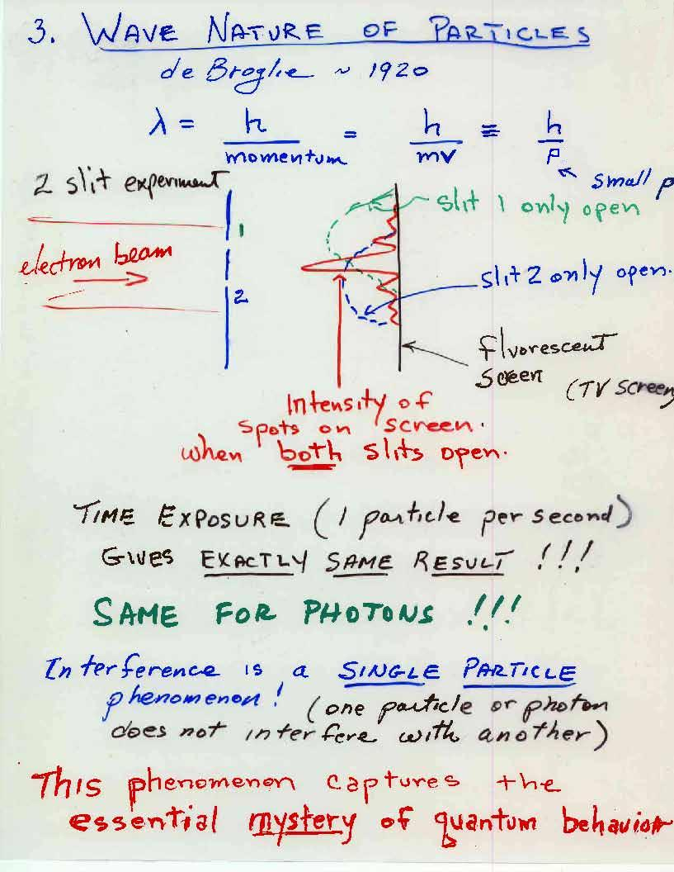

Slide 13

Results of a double-slit-experiment performed by Dr. A. Tonomura showing the build-up of an interference pattern of single electrons. Numbers of electrons are 10 (a), 200 (b), 6000 (c), 40000 (d), 140000 (e).
(Provided with kind permission of Dr. AkiraTonomura.)

Slide 14
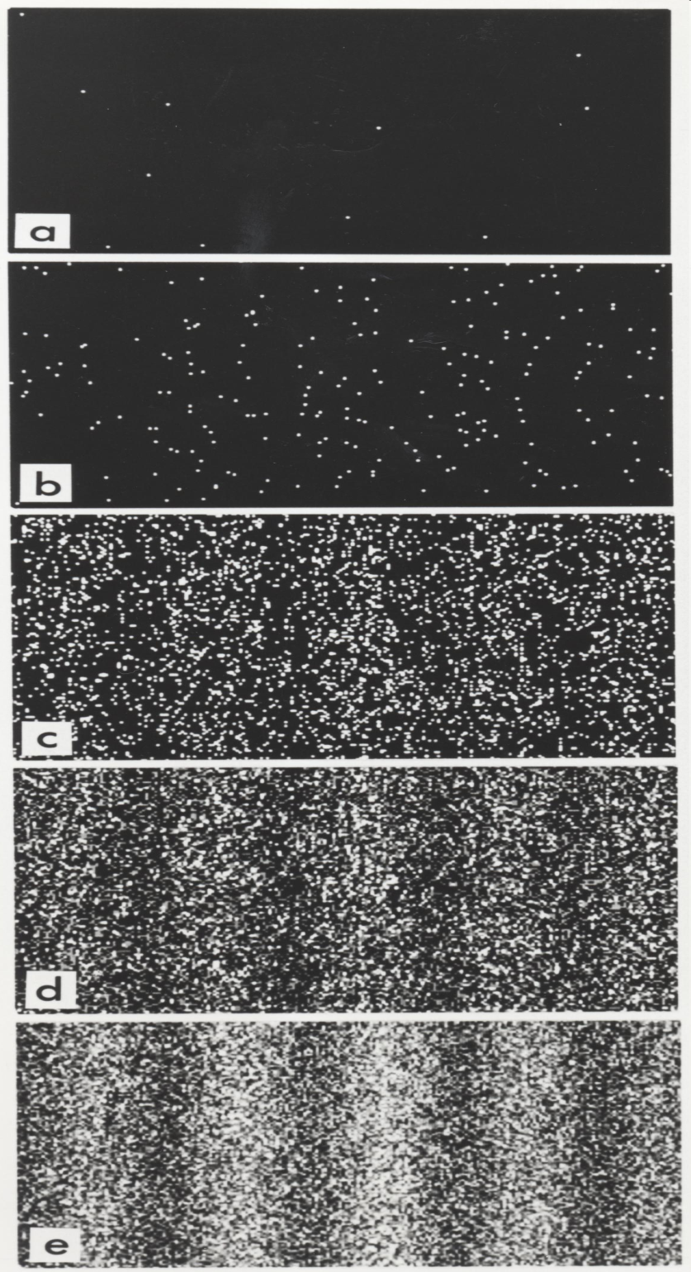
Results of a double-slit-experiment performed by Dr. A. Tonomura showing the build-up of an interference pattern of single electrons. Numbers of electrons are 10 (a), 200 (b), 6000 (c), 40000 (d), 140000 (e).
(Provided with kind permission of Dr. AkiraTonomura.)
Electron or photon interference is a
single particle phenomenon!
Movies available at:
http://www.hitachi.com/rd/research/em/movie.html

Slide 15
Time dependent Schrödinger Equation
It says by inspection that the future of a quantum state is predicted, IF
one knows the wavefunction at a given time.
(we never do, except for very simple experiments)
All (non-relativistic) dynamics in nature are in principle described
by this simple equation! Only limited by computer size and power.
Below are videos of time dependent quantum computations of an electron
moving through single and double slits.

Slide 16
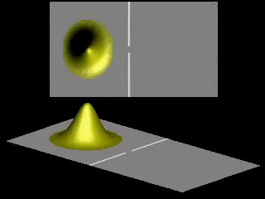
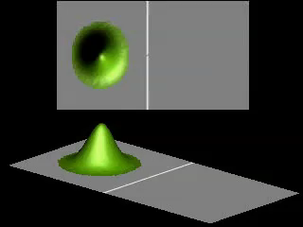
Time dependent Schrödinger Equation Applied to a moving SINGLE particle
A moving “particle” is described by a superposition of many sin and cos waves which constructively interfere to give a spherical Gaussian probability near a certain point but destructively interfere everywhere else.
The Gaussian “wave packet” moves according to the kinetic energy given by
the average frequency of the sin waves. This is how Newton’s Laws emerge
from quantum theory.
Large single slit
This demonstrates very well the uncertainty
principle, and the generation of kinetic energy
during the confinement while passing through
the slit, resulting in large spreading of the
wavefunction after emerging from slit.
Very small single slit

Slide 17
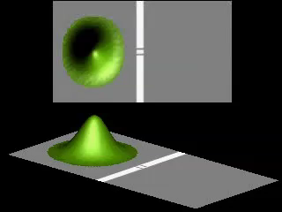
A moving “particle” is described by a superposition of a great many
sin and cos waves which constructively interfere to give a Gaussian
probability near a certain point but destructively interfere everywhere else.
The Gaussian “wave packet” moves according to the kinetic energy given by
the average frequency of the sin waves. This is how Newton’s Laws emerge
from quantum theory.
Slits CLOSE together

Slide 18
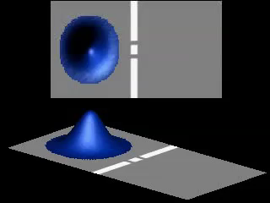
Slits FAR apart

Slide 19
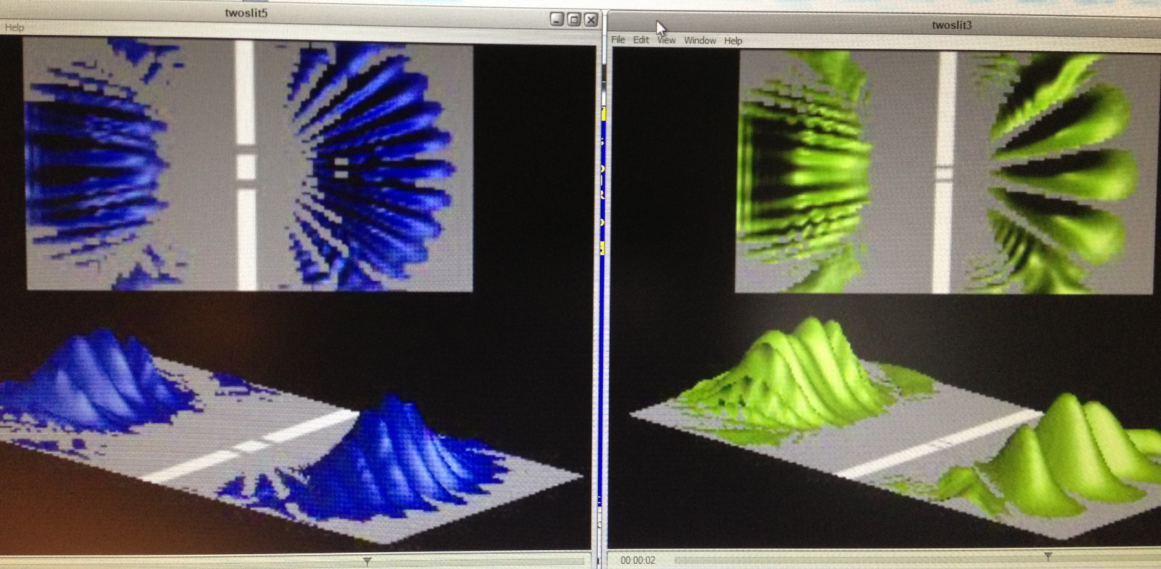

Slide 20
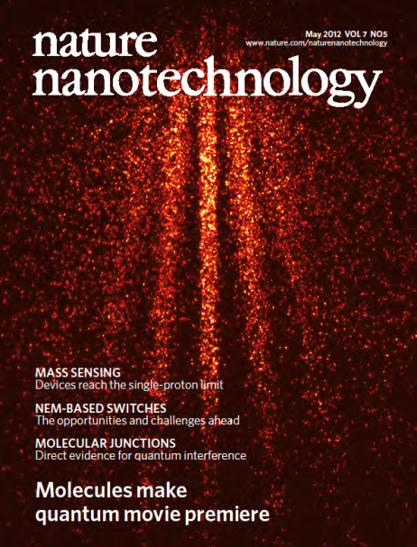
http://www-lpl.univ-paris13.fr/icap2012/docs/Juffmann_poster.pdf
http://www.youtube.com/watch?v=NUS6_S1KzC8

